Slide 1
Thermal Circuit Analysis of Droplet Evaporation on
Hot Microstructured Superhydrophobic Surfaces
Wenge Huang
Department of Mechanical Engineering
Virginia Tech
Blacksburg, VA 24061
Xukun He
Department of Mechanical Engineering
Virginia Tech
Blacksburg, VA 24061
Jiangtao Cheng
Department of Mechanical Engineering
Virginia Tech
Blacksburg, VA 24061

Slide 2
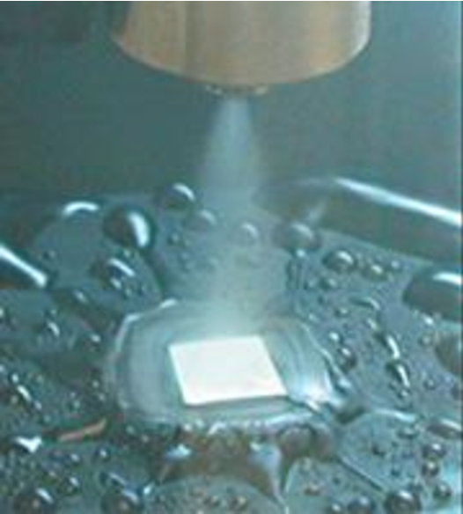
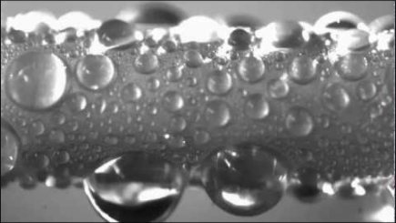
Background
Spray cooling on a heated surface
Heat transfer between droplet and heated surface
Website: www.valcompanies.com
N.Miljkovic et al. Nano letter,2013
Notes:
Droplet evaporation has important applications on heated surfaces, such as the spray cooling. There are many studies about droplet evaporation on heated smooth surface. But little attention has been paid to the heated microstructure surfaces.

Slide 3
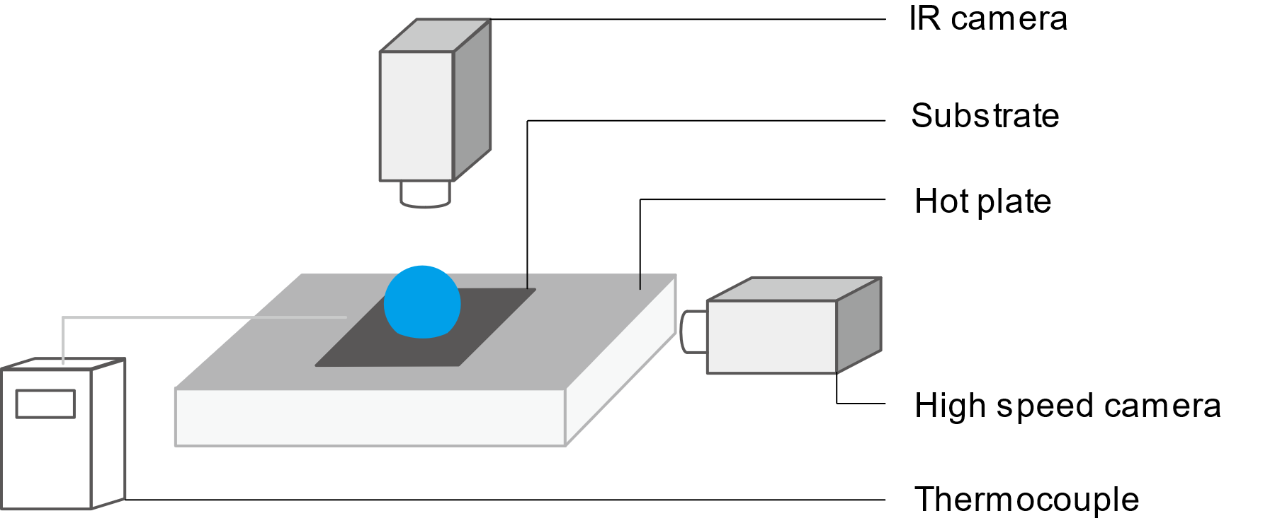
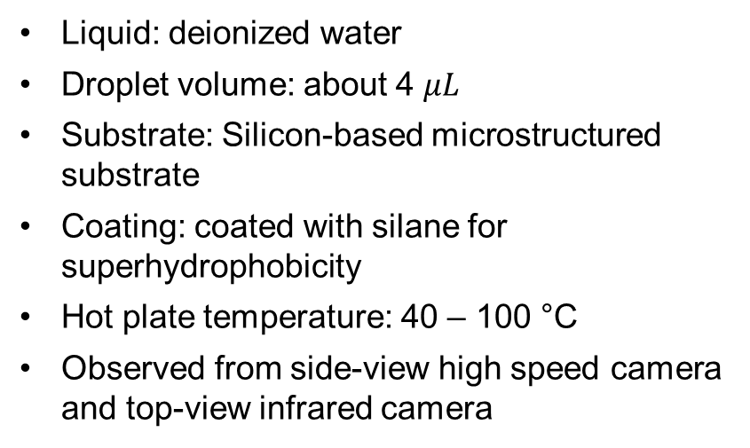
Experiment Setup
Liquid: deionized water
Droplet volume: about 4 $μL$
Substrate: Silicon-based microstructured substrate
Coating: coated with silane for superhydrophobicity
Hot plate temperature: 40 – 100 °C
Observed from side-view high speed camera and top-view infrared camera
Diagram of experiment setup
Notes:
So we want to know how droplet evaporates on heated microstructured surfaces.

Slide 4


Evaporation Processes
Speed up x 20
Speed up x 12
Evaporation on 80 °C substrate
Evaporation on 100 °C substrate

Slide 5

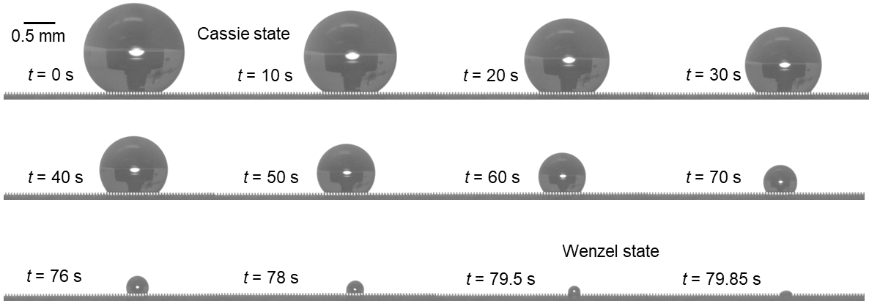

Wetting State
Assumption: Droplet is always in Cassie state
Cassie state
Snapshots of droplet evaporation process
Wenzel state
Cassie state (most of the evaporation process)
Droplet wetting state:
Wenzel state (very end of the evaporation process)

Slide 6
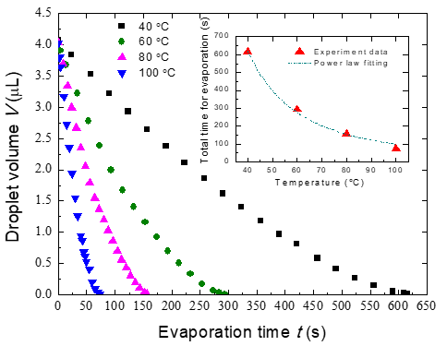
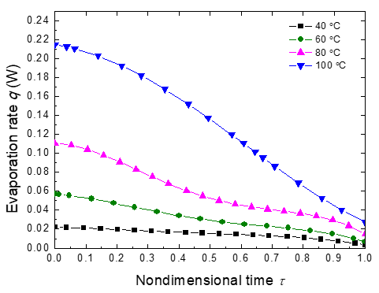
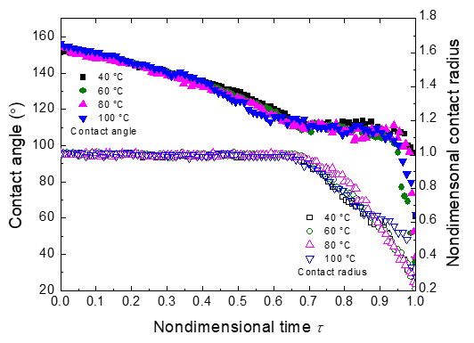
Evaporation Dynamics
Variation of droplet volume with total evaporation time
Variation of droplet evaporation rate with nondimensional time
Variation of contact angle and nondimensional contact radius with nondimensional time
Notes:
Here are the data we collected about the droplet during the evaporation

Slide 7
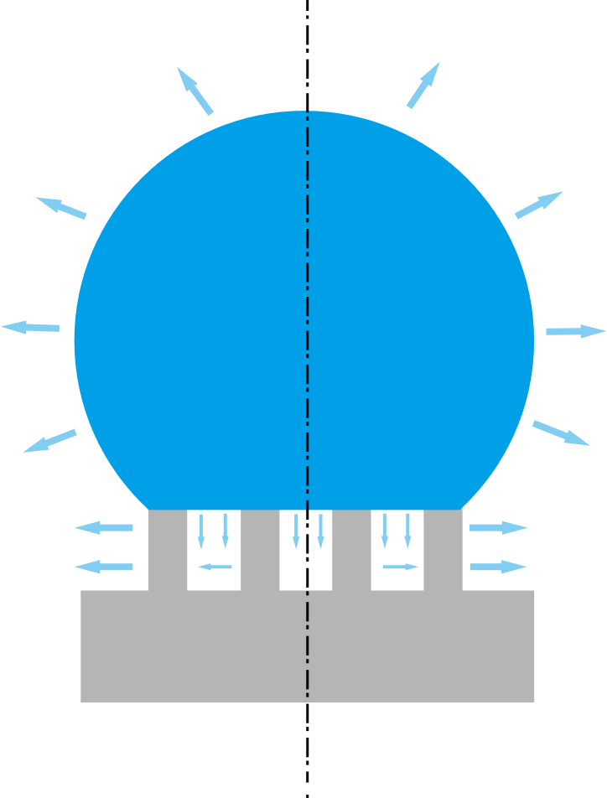
Droplet Evaporation Parts
There are two distinguished evaporation parts:
Evaporation from droplet cap
Evaporation from droplet base
Diagram of droplet evaporation on hot substrate

Slide 8
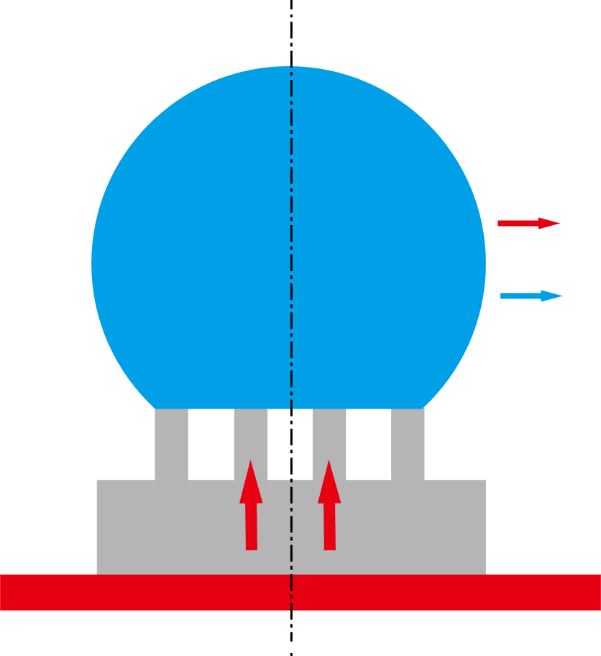



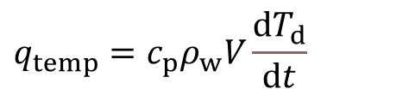


Energy Balance Model
Energy balance equation:
$q_{s}=q_{temp}+q_{conv}+q_{rad}+q_{evap}$
$$q_{temp}=c_{p}ρ_{w}V\frac{dT_{d}}{dt}$$
heat
Temperature increase
mass
Convective heat transfer
$$q_{conv}=h_{conv}S\left(T_{i}^{ }−T_{∞}^{ }\right)$$
Radiative heat transfer
$$q_{rad}=εσS\left(T_{i}^{4}−T_{∞}^{4}\right)$$
$q_{evap}=h_{fg}ρ_{w}\frac{dV}{dt}$
Evaporative heat transfer
heat
Evaporative heat transfer rate is much larger than the summation of the rest three parts
$q_{s}=q_{evap}$
Diagram of heat and mass transfer

Slide 9
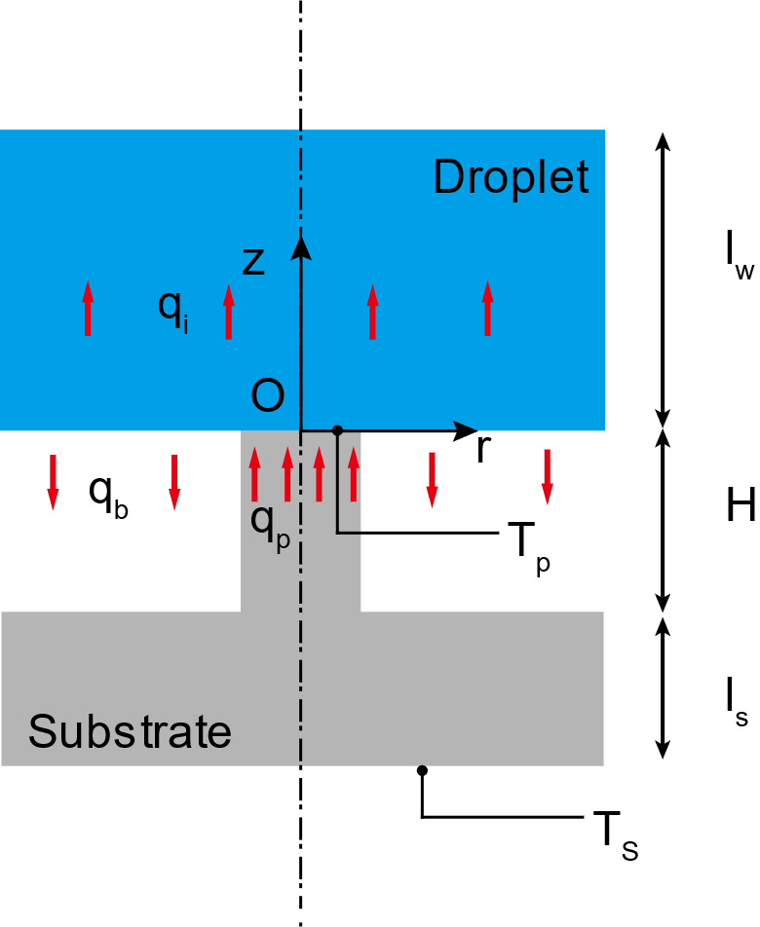
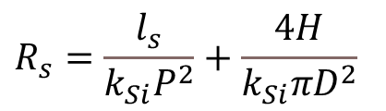
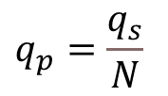

Heat Transfer in Micropillars
Heat transfer rate in one unit cell:
$$q_{p}=\frac{q_{s}}{N}$$
Thermal resistance of the silicon substrate:
$$R_{s}=\frac{l_{s}}{k_{Si}P^{2}}+\frac{4H}{k_{Si}{πD}^{2}}$$
Temperature on the top surface of the micropillar:
$$T_{p}=T_{s}−{q_{p}R}_{s}$$
Diagram of heat transfer in micropillars

Slide 10
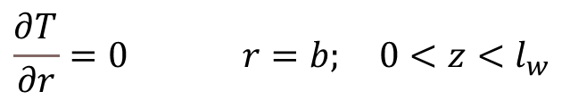


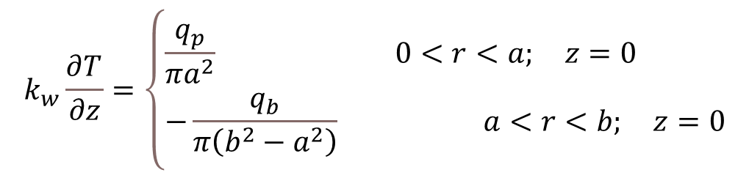
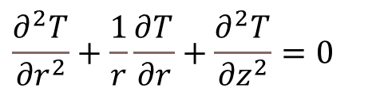
Heat Transfer in Water
Conductive heat transfer equation:
$$\frac{∂^{2}T_{ }}{{∂r}^{2}}+\frac{1}{r}\frac{∂T_{ }}{∂r}+\frac{∂^{2}T_{ }}{{∂z}^{2}}=0$$
Boundary conditions:
$$k_{w}\frac{∂T_{ }}{∂z}=\left\{\begin{aligned}&\frac{q_{p}}{πa^{2}} 0<r<a; z=0 \\ &−\frac{q_{b}}{π\left(b^{2}−a^{2}\right)} a<r<b; z=0\end{aligned}\right.$$
$$a$$
$$b$$
$$\frac{∂T_{ }}{∂r}=0 r=b; 0<z<l_{w}$$
$$T_{ }\left(r;z\right)=T_{w} 0<r<b; z=l_{w}$$
Diagram of heat transfer from micropillar to droplet

Slide 11
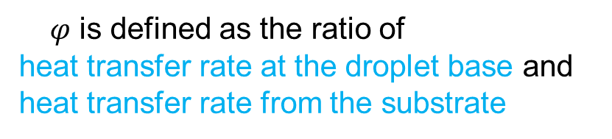
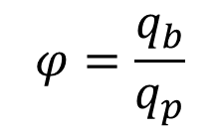
Temperature Distribution
Solution of the heat transfer equation
$$T_{b}(r,z)=T_{w}+\frac{q_{p}\left(l_{w}−z\right)}{πk_{w}}\left(\frac{\left(1−φ\right)}{b^{2}}\right)+\frac{2aq_{p}}{πk_{w}}\left(\frac{1}{a^{2}}+\frac{φ}{b^{2}−a^{2}}\right)\sum_{n=1}^{∞}{\left[J_{1}\left(\frac{a}{b}α_{n}\right)J_{0}\left(\frac{r}{b}α_{n}\right){/\left(α_{n}^{2}J_{0}^{2}\left(α_{n}\right)\right)}\right]}\frac{\sinh\left(\left.\frac{α_{n}}{b}{\left(l\right.}_{w}−z\right)\right)}{\cosh\left(\frac{α_{n}}{b}l_{w}\right)}$$
$$T_{b}(r,0)=T_{w}+\frac{q_{p}l_{w}}{πk_{w}}\left(\frac{\left(1−φ\right)}{b^{2}}\right)+\frac{2aq_{p}}{πk_{w}}\left(\frac{1}{a^{2}}+\frac{φ}{b^{2}−a^{2}}\right)\sum_{n=1}^{∞}{\left[J_{1}\left(\frac{a}{b}α_{n}\right)J_{0}\left(\frac{r}{b}α_{n}\right){/\left(α_{n}^{2}J_{0}^{2}\left(α_{n}\right)\right)}\right]}\tanh\left(\frac{α_{n}}{b}l_{w}\right)$$
$φ$ is defined as the ratio of
heat transfer rate at the droplet base and
heat transfer rate from the substrate
$$φ=\frac{q_{b}}{q_{p}}$$

Slide 12
Temperature Distribution
Solution of the heat transfer equation
$$T_{b}(r,z)=T_{w}+\frac{q_{p}\left(l_{w}−z\right)}{k_{w}}\left(\frac{a^{2}}{b^{2}}\left(1+φ\right)−φ\right)+\frac{2aq_{p}\left(1+φ\right)}{k_{w}l_{w}}\sum_{n=1}^{∞}{\left[J_{1}\left(\frac{a}{b}α_{n}\right)J_{0}\left(\frac{r}{b}α_{n}\right){/\left(α_{n}^{2}J_{0}^{2}\left(α_{n}\right)\right)}\right]}\frac{\sinh\left(\left.\frac{α_{n}}{b}{\left(l\right.}_{w}−z\right)\right)}{\cosh\left(\frac{α_{n}}{b}l_{w}\right)}$$
$$T_{b}(r,0)=T_{w}+\frac{q_{p}l_{w}}{k_{w}}\left\{\frac{a^{2}}{b^{2}}\left(1+φ\right)−φ+\frac{2a\left(1+φ\right)}{l_{w}}\sum_{n=1}^{∞}{\left[J_{1}\left(\frac{a}{b}α_{n}\right)J_{0}\left(\frac{r}{b}α_{n}\right){/\left(α_{n}^{2}J_{0}^{2}\left(α_{n}\right)\right)}\right]}\tanh\left(\frac{α_{n}}{b}l_{w}\right)\right\}$$
$φ$ is defined as the ratio of
heat transfer rate at the droplet base and
heat transfer rate from the substrate
$$φ=\frac{q_{b}}{q_{p}}$$

Slide 13
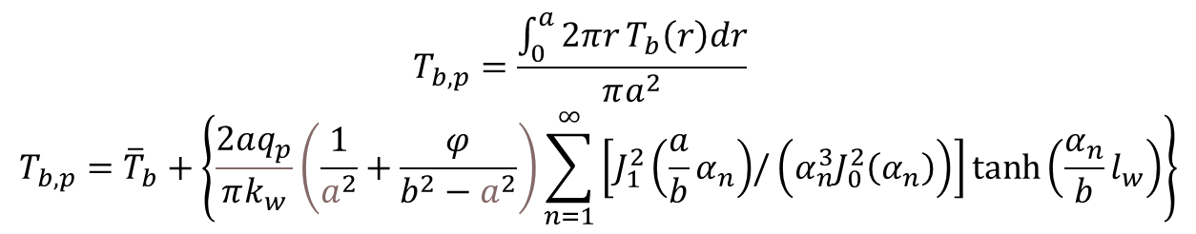
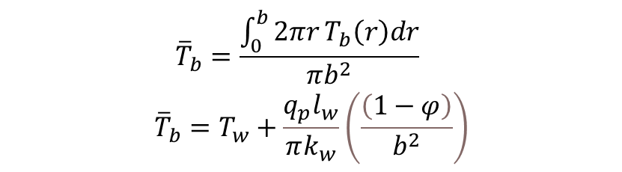
Average Temperature at the Droplet Base
Average temperature of water at the droplet base:
$${\overline{T}}_{b}=\frac{\int_{0}^{b}{2πr}T_{b}\left(r\right)dr}{πb^{2}}$$
$${\overline{T}}_{b}=T_{w}+\frac{q_{p}l_{w}}{πk_{w}}\left(\frac{\left(1−φ\right)}{b^{2}}\right)$$
Average temperature at liquid-solid interface:
$$T_{b,p}=\frac{\int_{0}^{a}{2πr}T_{b}\left(r\right)dr}{πa^{2}}$$
$$T_{b,p}={\overline{T}}_{b}+\left\{\frac{2aq_{p}}{πk_{w}}\left(\frac{1}{a^{2}}+\frac{φ}{b^{2}−a^{2}}\right)\sum_{n=1}^{∞}{\left[J_{1}^{2}\left(\frac{a}{b}α_{n}\right){/\left(α_{n}^{3}J_{0}^{2}\left(α_{n}\right)\right)}\right]}\tanh\left(\frac{α_{n}}{b}l_{w}\right)\right\}$$

Slide 14
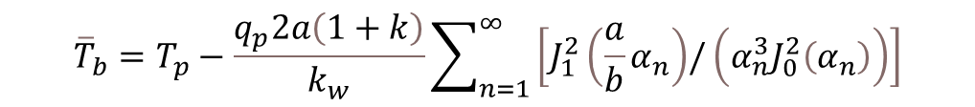
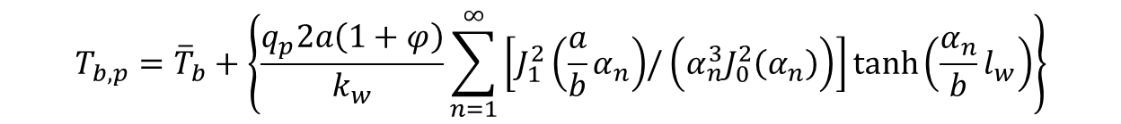

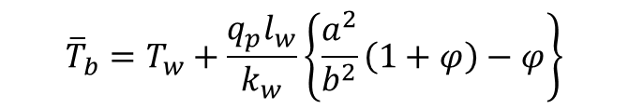
Temperature Continuity
Expressions for average temperature
$${\overline{T}}_{b}=T_{w}+\frac{q_{p}l_{w}}{k_{w}}\left\{\frac{a^{2}}{b^{2}}\left(1+φ\right)−φ\right\}$$
$$T_{b,p}={\overline{T}}_{b}+\left\{\frac{q_{p}2a\left(1+φ\right)}{k_{w}}\sum_{n=1}^{∞}{\left[J_{1}^{2}\left(\frac{a}{b}α_{n}\right){/\left(α_{n}^{3}J_{0}^{2}\left(α_{n}\right)\right)}\right]}\tanh\left(\frac{α_{n}}{b}l_{w}\right)\right\}$$
Temperature continuity at the solid-liquid interface
$$T_{b,p}=T_{p}$$
$${\overline{T}}_{b}=T_{p}−\frac{q_{p}2a\left(1+k\right)}{k_{w}}\sum_{n=1}^{∞}{\left[J_{1}^{2}\left(\frac{a}{b}α_{n}\right){/\left(α_{n}^{3}J_{0}^{2}\left(α_{n}\right)\right)}\right]}$$
Average temperature at the droplet base

Slide 15
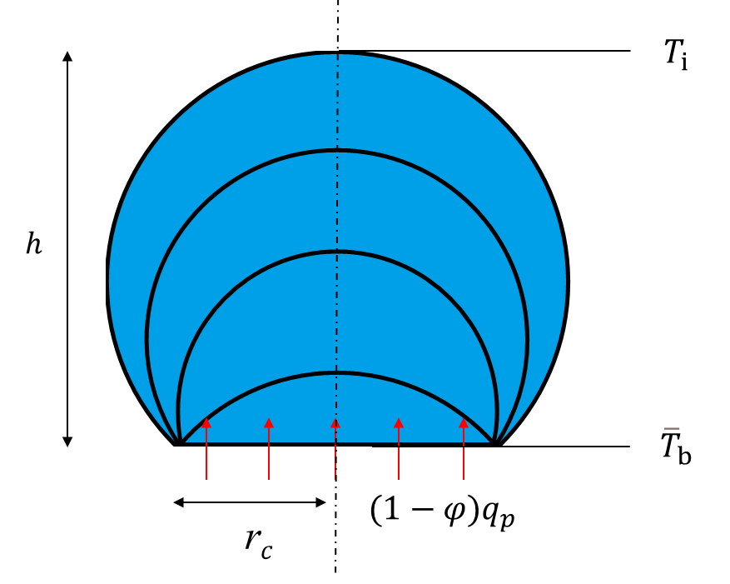

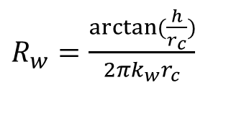
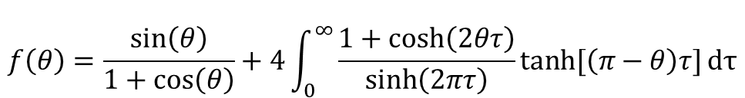



Heat Transfer Inside the Droplet
Assumption:
Temperature is uniform on the droplet cap surface
$R_{w}=\frac{arctan⁡(\frac{h}{r_{c}})}{2πk_{w}r_{c}}$
Thermal resistance of the water droplet:
Interface temperature at the droplet cap:
$$T_{i}={\overline{T}}_{b}−\left(1−φ\right)q_{s}R_{w}$$
Evaporation rate from the droplet cap surface based on the diffusion-driven model:
$$q_{e}={{πr}_{c}D_{d}\left(c_{s}−H_{h}c_{∞}\right)f\left(θ\right)h}_{fg}$$
$$f\left(θ\right)=\frac{sin\left(θ\right)}{1+cos\left(θ\right)}+4\int_{0}^{∞}{\frac{1+cosh\left(2θτ\right)}{sinh\left(2πτ\right)}tanh⁡[\left(π−θ\right)τ]}dτ$$
$(1−φ)q_{s}$
Evaporation flux from the droplet cap should be the same as the heat flux transferred through the water droplet
Diagram of heat transfer through the droplet
$q_{e}=(1−φ)q_{s}$

Slide 16
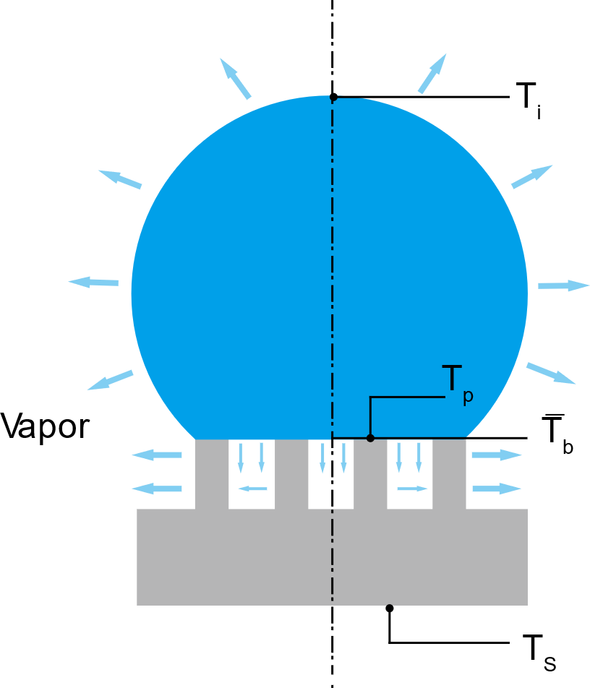

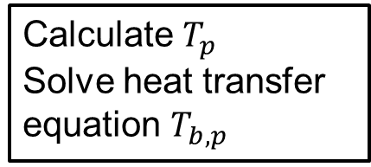
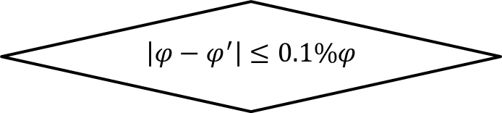

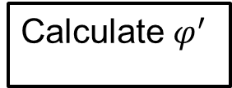


Algorithm for Interface Temperature and Evaporation Ratio
Input $T_{s}$, $q_{p}$, $φ$
Calculate $T_{p}$
Solve heat transfer equation $T_{b,p}$
$φ$= $φ^{′}$
Calculate ${\overline{T}}_{b}$, $T_{i}$, $q_{e}$
Calculate $φ^{′}$
No
Yes
$$\left|φ−φ^{′}\right|≤0.1\%φ$$
Output $T_{model}$, $φ$

Slide 17
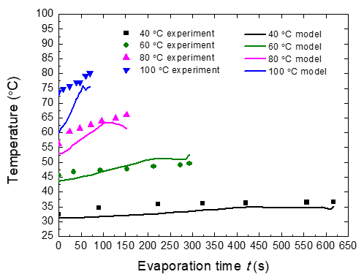
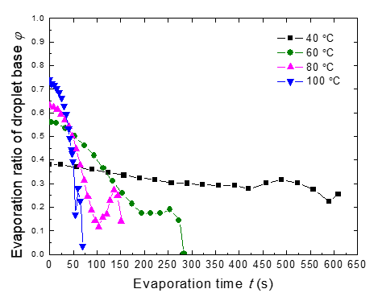
Interface Temperature and Evaporation Ratio
Droplet interface temperature
Evaporation ratio of droplet base

Slide 18
Conclusions
Large temperature mismatch exists between droplet cap surface and the heated substrate. The temperature difference increases with the rise of substrate temperature.
Interface temperature of the droplet cap increases with the rise of substrate temperature. Interface temperature of the droplet cap increases during the evaporation process.
Evaporation ratio of the droplet base increases with the rise of the substrate temperature. Evaporation ratio of the droplet base decreases during the evaporation process.

Slide 19
Thank You

